Slide 1

The Solar Cell Manufacturing process
Maximizing Efficiency and Performance in Solar Cell Production

Slide 2
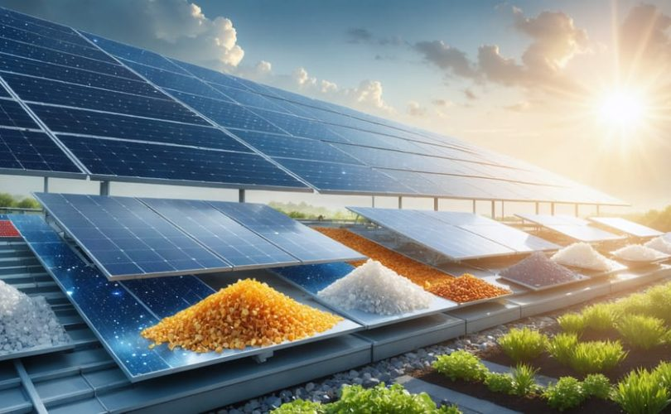
Introduction
This presentation outlines the critical steps leading to the successful output of a solar cell working model. It highlights the manufacturing process, from doping and coating to final assembly and testing. Emphasizing precision and optimization, we aim to deliver a comprehensive understanding of how solar cells effectively convert sunlight into usable energy.

Slide 3

Manufacturing Process Overview
01

Slide 4
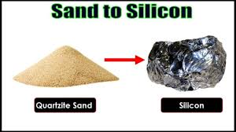
Silicon Processing & Purification
Start with quartzsand (SiO2)
Reduce in an electric arc furnace → metallurgical-grade silicon.
Further purified (via Siemens process) to electronic-grade silicon (99.9999%).

Slide 5

Anti-Reflective Coating (ARC)
The implementation of an anti-reflective coating significantly enhances light absorption in solar cells. By reducing reflection, this step boosts the overall efficiency of solar energy conversion, ensuring maximum output.

Slide 6

Ingot Formation
Melt purified silicon at high temperature
Use Czochralski method to grow single crystal silicon ingot
Result: Cylindrical silicon ingot for wafer slicing

Slide 7
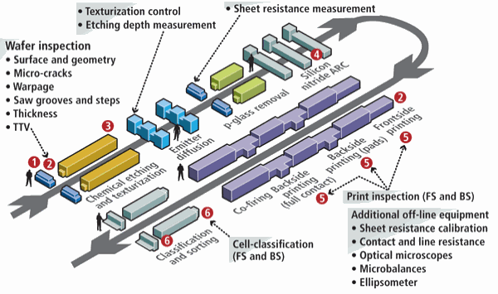
Wafer Slicing
Slice ingot into thin wafers using diamond wire saws
Polish wafers to remove surface defects
Prepare wafers for cell fabrication

Slide 8
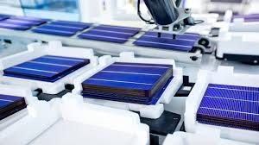
Wafer Treatment
Texture wafers chemically to reduce reflection(KOH&NaOH)
Dope wafers with phosphorus/boron to create p-n junction
Essential for converting sunlight to electricity

Slide 9
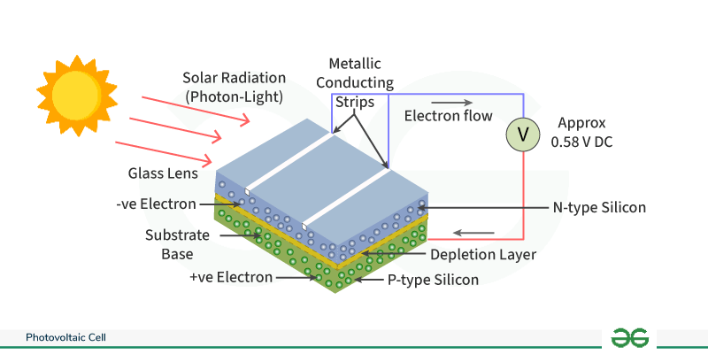
Doping – P-N Junction Formation
The doping process is essential for creating the P-N junction, which forms the electric field necessary for photovoltaic action. This process establishes the foundation for converting sunlight into electricity effectively.

Slide 10
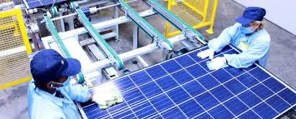
Solar Cell Fabrication
Apply anti-reflective coating (e.g., silicon nitride)
Screen-print silver contacts for current collection
Test each cell for efficiency and quality
.

Slide 11
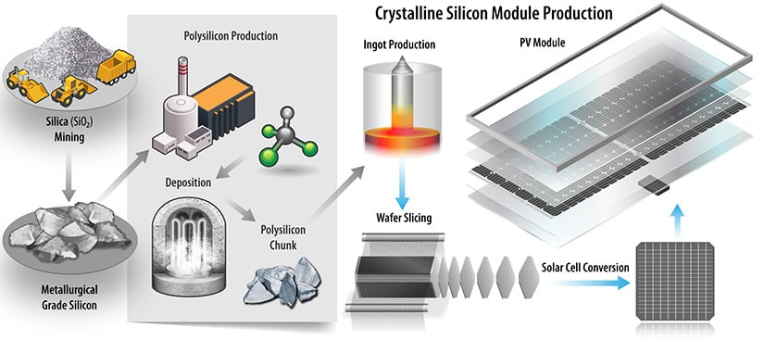
Metallization
Metallization involves applying the necessary front and rear metal contacts, typically silver and aluminum. These contacts are crucial for allowing current collection and are vital for forming electrical circuits within the solar module, ensuring effective energy transfer.

Slide 12
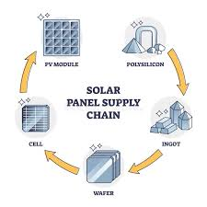
Module (Panel) Assembly
Connect cells in series/parallel (stringing)
Sandwich cells between glass and polymer layers with encapsulant
Laminate and seal module
Add aluminum frame and junction box
.

Slide 13

Final Testing and Integration

Slide 14
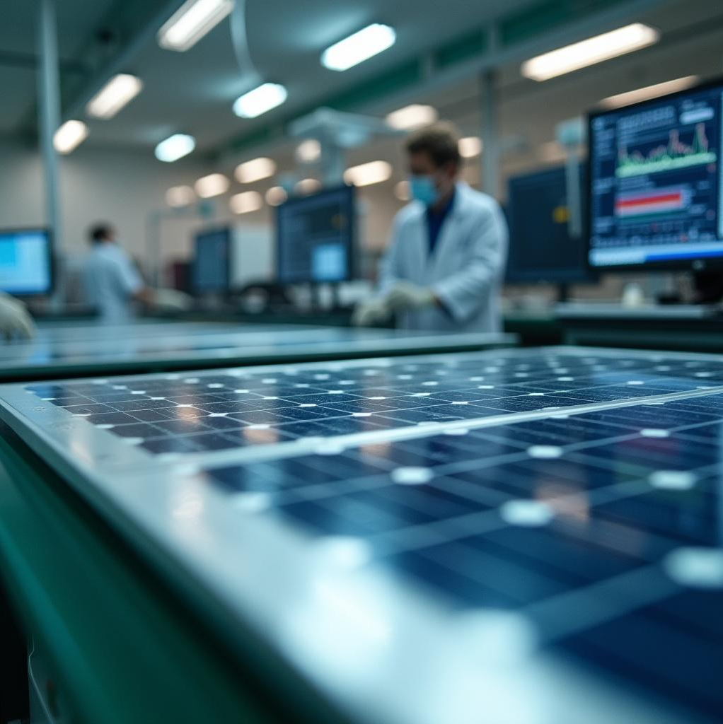
Testing and Sorting
Cells undergo rigorous testing under simulated sunlight conditions to evaluate their efficiency. Only those that meet performance standards are selected for module assembly, ensuring high-quality output and reliability.

Slide 15
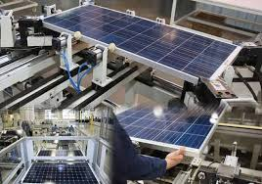
Testing and Quality Assurance
Electrical performance tests
Mechanical strength and weather resistance checks
Ensure durability and long-term reliability
.

Slide 16
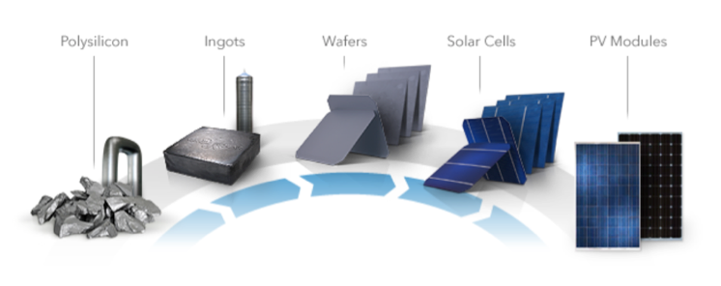
Module Assembly
During module assembly, functional solar cells are interlinked in series or parallel configurations. They are encapsulated between EVA, glass, and a backsheet, resulting in a robust and weatherproof solar panel ready for deployment.

Slide 17
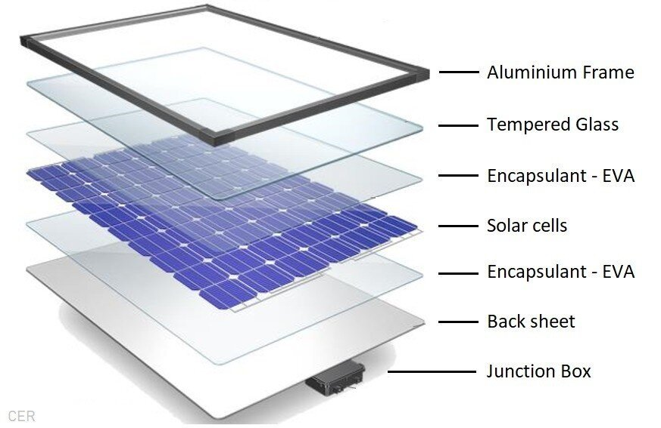
Solar Panel (Module) Assembly
Cell Interconnection
Solar cells are soldered in series/parallel to form strings.
Encapsulation
Cells are layered between EVA sheets, tempered glass (top), and a backsheet (bottom).
Lamination
The stack is vacuum-laminated to seal and protect the components.
Framing
An aluminum frame is added for structural strength and mounting.
Junction Box Installation
Attached at the back, enabling external electrical connection with bypass diodes.
Final Testing
The panel is tested for voltage, current, insulation, and durability under simulated sunlight.

Slide 18
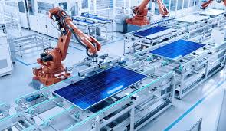
Junction Box Integration
The junction box is integrated to facilitate external electrical connections to the load or grid. This component is essential for providing a safe and efficient interface for energy distribution and grid connectivity.

Slide 19
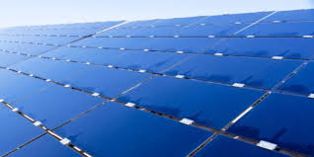
Installation and Grid Connection
Mount panels on roof or ground structure
Connect panels to inverter (DC → AC conversion)
Install bi-directional meter for measuring energy flow

Slide 20
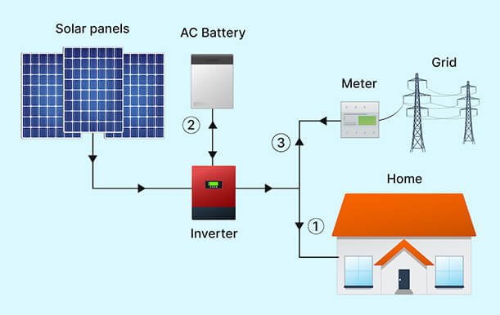
Power generation
Panel Installation
Panels are mounted on rooftops or open fields using fixed or tracking mounts.
Inverter Conversion
DC power from panels is converted to AC using solar inverters.
Power Conditioning
Voltage and frequency are stabilized and synchronized with the local grid.
Monitoring & Net Metering
Smart meters track solar generation, usage, and export to the grid.
Power Distribution
AC power is used for home appliances, stored in batteries (optional), or exported to the electrical grid.

Slide 21
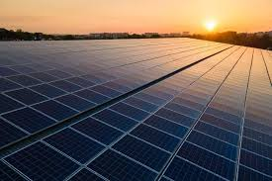
Benefits of Solar Energy
Renewable and clean energy source
Reduces electricity bills
Low maintenance and long lifespan
Supports energy independence and sustainability

Slide 22
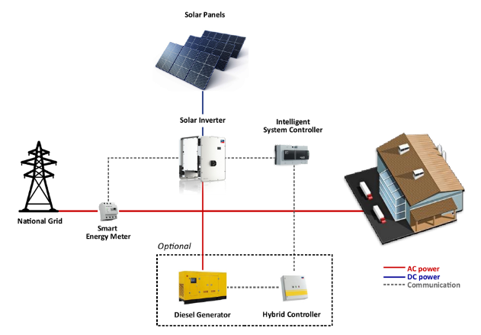
Conclusions
The solar cell manufacturing process encompasses critical steps from doping to module assembly. Each phase ensures optimal functionality and efficiency, resulting in a reliable solar energy solution designed to harness renewable energy effectively.

Slide 23

Thank you
Turning rays into power, and ideas into impact.

